Slide 1
AI Lab PROJECT
TEAM MEMBERS:
SAGAR SINHA
SAUMYA SHAH
HEEM AMIN
RACHIT GADIA
ISHITA SINGH
AMAN SHAH

Slide 2
DOMAIN – Computer Vision
INTRODUCTION:
Our project is based upon Object Detection which forms one of the core areas of work in Computer Vision. Under the aforementioned sub-domain, the machine is made to identify(classification/prediction) the object under consideration and able to draw bounding boxes(annotate) the region of space of object. For our problem, we are going to use a CNN- based deep learning model using transfer learning.

Slide 3
Inspiration and motivation
Vehicle detection and tracking applications play an important role for civilian and military applications such as in highway traffic surveillance control, management and urban traffic planning.
Accidents are often caused due to speeding vehicles, and hence it is an utmost priority to prevent the vehicles from collision, thereby leading to accidents.
Providing realtime metrics such as relative distance between the two vehicles, and the direction of travel are some of the important metrics which can be computed in this regard.
Albeit significant research has been done in this domain, the work hasn’t stagnated owing to the new challenges which are coming up every passing day.

Slide 4
VEHICLE TYPE VISUAL RECOGNITION IN REAL-TIME
Vehicle type classification and detection using image data
Pre-Trained models from TF Hub would be used for the data
Using transfer learning methods, we will feed the model with newer training data and allow the model to learn new features only on the new data being fed. Training won’t be done from scratch.

Slide 5
PROBLEM APPROACH
We aim to use SSD – Single Shot Multi-Box Detector model on the dataset of images of various types of vehicles. The object localization and detection(regression) are performed on a single forward pass of the network. Multi-Box refers to the bounding boxes around the classified images.
TF Garden provides many SOTA models which can pe transfer-learned or pre-trained from scratch depending upon the use-case. In our case, since there will be multiple categories of vehicles, we will fine-tune the configurations of the model to suit our purpose.

Slide 6
Paper and dataset references
Title | Link(s) | About
Review of vehicle detection techniques | Link | Detection and vehicle tracking approaches
SSD : Single-Shot Multi-Box detector | Link | A single DNN-based object detection architecture
Different object detection algorithms | Link | Different approaches to object detection
Dataset source | Link | A large dataset comprising of 16 classes of unlabelled training and validation images of vehicles

Slide 7
DATASET DESCRIPTION
Link for dataset - https://www.kaggle.com/c/vehicle/data
The data contains vehicles from altogether 17 classes: Ambulance, Boat, Cart, Limousine, Snowmobile, Truck, Barge, Bus, Caterpillar, Motorcycle, Tank, Van, Bicycle, Car, Helicopter, Segway, Taxi
We will use only 4 categories – Bicycle, Car, Ambulance and Bus for our object detection problem and manually annotate the images using open-source packages named label-Image.

Slide 8
DATASET DESCRIPTION
The training set: a set of images with true labels in the folder names. The zip file contains altogether 28045 files organized in folders. The folder name is the true class; i.e., "Boat" folder has all boat images, "Car" folder has all the car images and so on.
The test set: a set of images with true labels in the folder names. The zip file contains altogether 28045 files organized in folders. The folder name is the true class; i.e., "Boat" folder has all boat images, "Car" folder has all the car images and so on.
As stated earlier, we won’t be using all the images, just a subset of the training and test datasets. And our model is already prepared.

Slide 9
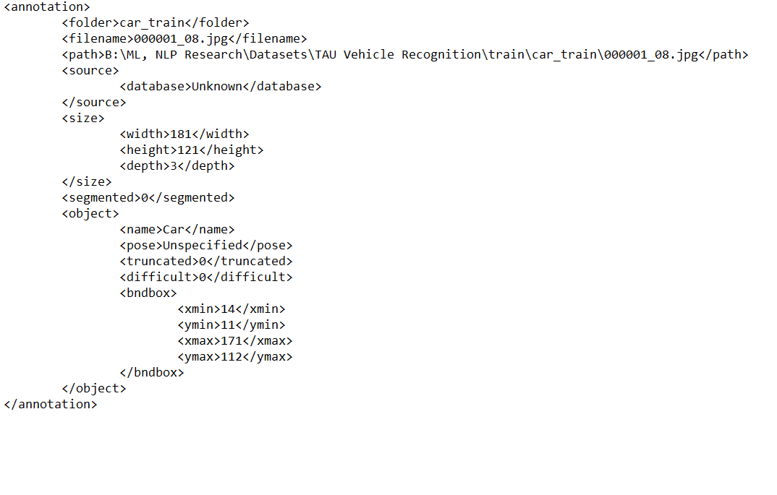
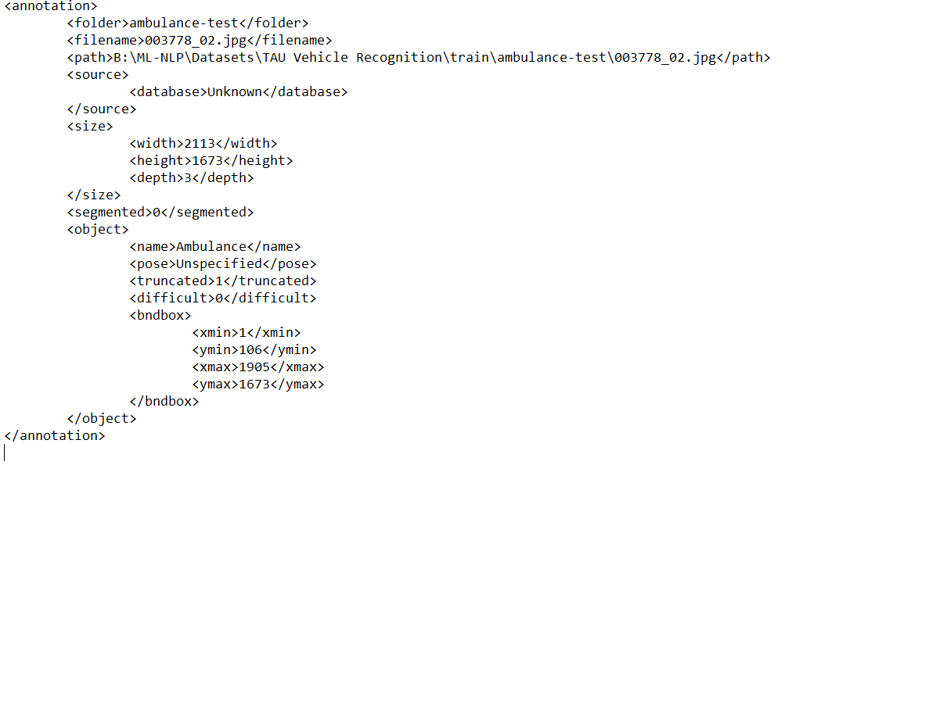
Annotations and Labels

Slide 10
SOME PIPELINE CONFIGURATION PARAMETERS
Number of classes : 3
Model trained until the validation loss is below 0.28 consistently over some epochs. (in our case 3 epochs)
Batch size : 16
Optimizer : SGD(Stochastic Gradient Descent) with L2 - Norm

Slide 11
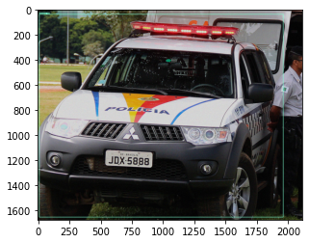
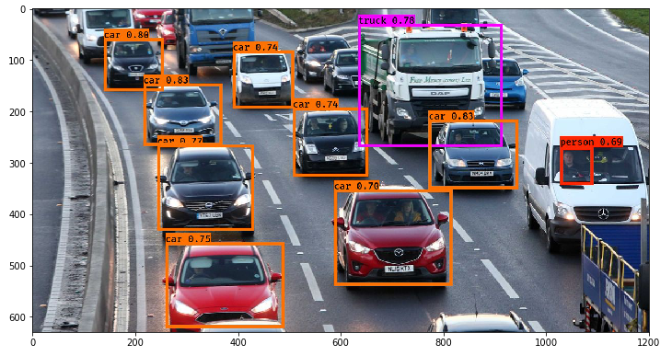
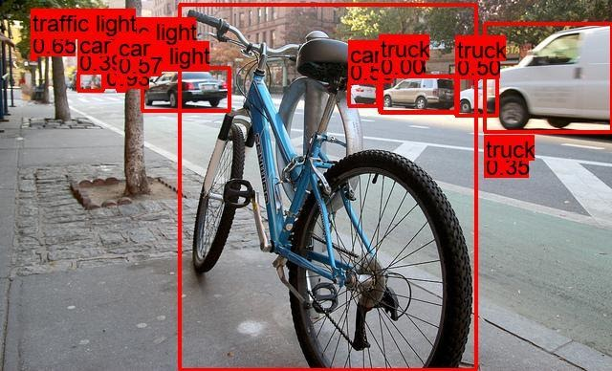
Validated ImagES

Slide 12
FUTURE WORK
We plan to extend our work in building a robot for which we will finetune the model for serving on edge devices.

Slide 13
FURTHER References and Tools:
SSD paper introduction - https://towardsdatascience.com/understanding-ssd-multibox-real-time-object-detection-in-deep-learning-495ef744fab
A comparison of different Deep Learning Techniques for object detection - https://cv-tricks.com/object-detection/faster-r-cnn-yolo-ssd/ - We didn’t try out Faster R-CNN model though
OID .txt format to Pascal VOC format PyPI library - https://pypi.org/project/oidv6-to-voc

Slide 14
THANK YOU!

